Slide 1
Extract, transform, load
MTN.BI.08
Dimension Tables’ Techniques
Elias Nema
Senior Software Engineer
Elias_Nema@epam.com

Slide 2
Agenda
Dimension Concepts
Conformed Dimensions
[Recursive] Subqueries
Hierarhical Queries

Slide 3
Dimension concepts

Slide 4
Which Dimension needs Surrogate?
In a star schema, each dimension table is assigned a surrogate key.
Surrogate keys are usually integers, generated and managed as part of the extract, transform, load (ETL) process that loads the star schema.
In each row of the dimension table, the surrogate has a unique value.

Slide 5
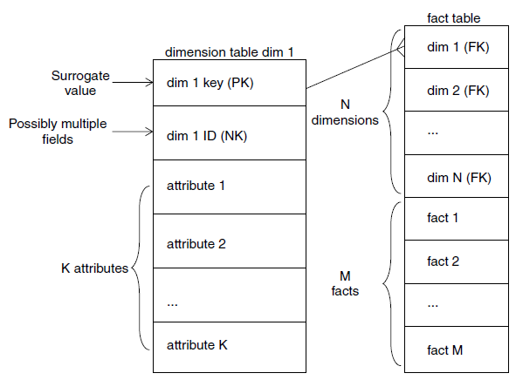
Dimension’s Surrogate Keys

Slide 6
Natural Key
Separate and distinct from surrogate keys, one or more natural keys will also be present in most dimension tables.
The natural keys are identifiers carried over from source systems. They may not uniquely identify a row in the data warehouse, but they do identify a corresponding entity in the source system.

Slide 7
Other Column Types
Codes and Descriptions
Flags and Their Values
Dimensions with Numeric Values
Behavioral Dimensions* (computed based on facts)
…

Slide 8
Splitting Dimensions
FCT_Sales
Event_dt
Product_id
Customer_id
Sales_rev
…
DIM_Customer_part1
1-to-1
DIM_Customer_part2

Slide 9
Mini Dimensions
FCT_Sales
Event_dt
Product_id
Customer_id
Sales_rev
…
DIM_Customer
Customer_id
Cust_name
Cust_city
Age
Income
Rating
Segment
Credit Score
Weight
Mini-dimension is a subset of attributes from a large dimension that tend to change rapidly.
Fast Changing Attributes

Slide 10
Dimension Roles and Aliasing
Measurement of a business process can involve more than one instance of a dimension.
Using database views, a separate view of the dimension table is created to represent each role.
But even creating views is not necessary, because the SQL standard includes the concept of aliasing.

Slide 11
NULLs in Dimensions
In developing reports, NULLs cause myriad problems that can make the calmest of analysts start pulling their hair out. The problems they encounter all stem from the special status of the NULL: it is not a value and has no meaning.
Because: NULL != anything (even NULL)

Slide 12
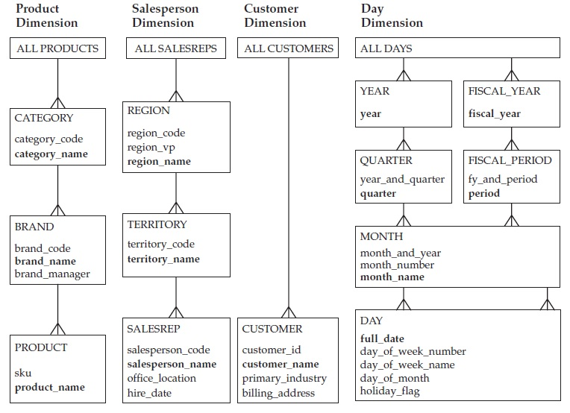
Hierarchies

Slide 13
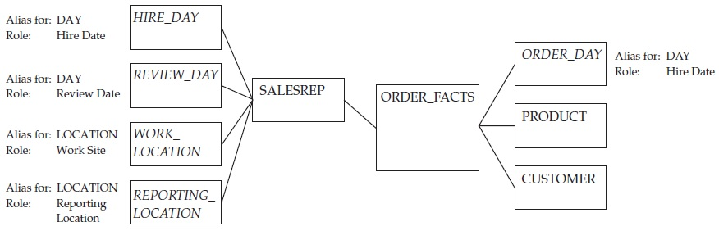
Outriggers
Advantages: consistent hierarchy, removing repeating groups, can remove “heavy” columns from the table.
Weaknesses: loose flexibility, performance decreasing (as number of joins in increased), type 2 change in an outrigger has a ripple effect, requiring type 2 changes to all related rows in any associated dimension tables.
Notes:
http://www.kimballgroup.com/2008/09/design-tip-105-snowflakes-outriggers-and-bridges/

Slide 14
The Grain of a Dimension

Slide 15
The Grain of a Dimension
This mean the definition of the key of the dimension, in business terms.
Example is the commercial customer dimension. It is easy to say that the grain of the dimension is the commercial customer. It is often quite another thing to be absolutely sure that a given source file always implements that grain with a certain set of fields.
SELECT a, b, c, COUNT(*)
FROM some_dimension
GROUP BY a, b, c
HAVING COUNT(*) > 1

Slide 16
Conformed Diminsions

Slide 17
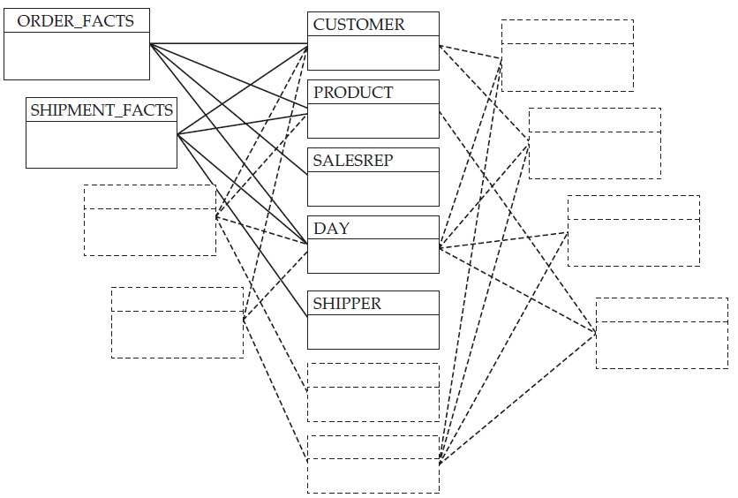
Conformed Dimensions

Slide 18
Conformed Dimensions
At a logical level, when a series of stars share a set of common dimensions, the dimensions are referred to as conformed dimensions.
When dimensions do not conform, short-term victories give way to long-term defeat.

Slide 19
Conformance Matrix
 | Day |  |  | Product |  | Salesrep |  |  | Customer | …
 | Day | Month | Quarter | Product | Category | Salesrep | Region | Division
order_facts | + | + | + | + | + | + | + | + | +
shipment_facts | + | + | + | + | + | + | + | + | +
inventory_facts | + | + | + | + | +
sales_goal_facts |  | + | + |  |  |  | + | +
demand_forecast_fact |  |  | + |  | + |  |  | +

Slide 20
[Recursive] Subqueries

Slide 21
WITH Subquery
with cust as (
select /*+ materialize gather_plan_statistics */
b.cust_income_level,
a.country_name
from sh.customers b
join sh.countries a on a.country_id = b.country_id )
select country_name, cust_income_level, count(country_name) country_cust_count
from cust c
having count(country_name) >
( select count(*) * .01
from cust c2 )
group by country_name, cust_income_level
The WITH query_name clause lets you assign a name to a subquery block. You can then reference the subquery block multiple places in the query by specifying query_name. Oracle Database optimizes the query by treating the query name as either an inline view or as a temporary table.

Slide 22
Execution Plan
-------------------------------------------------------------------------
| Id | Operation | Name | Starts | E-Rows | A-Rows |
-------------------------------------------------------------------------
| 0 | SELECT STATEMENT | | 1 | | 35 |
| 1 | TEMP TABLE TRANSFORMATION | | 1 | | 35 |
| 2 | LOAD AS SELECT | | 1 | | 0 |
|* 3| HASH JOIN | | 1 | 55500 | 55500 |
| 4 | TABLE ACCESS FULL | COUNTRIES | 1 | 23 | 23 |
| 5 | TABLE ACCESS FULL | CUSTOMERS | 1 | 55500 | 55500 |
|* 6| FILTER | | 1 | | 35 |
| 7 | SORT GROUP BY | | 1 | 18 | 209 |
| 8 | VIEW | | 1 | 55500 | 55500 |
| 9 | TABLE ACCESS FULL | SYS_TEMP_0F| 1 | 55500 | 55500 |
| 10| SORT AGGREGATE | | 1 | 1 | 1 |
| 11| VIEW | | 1 | 55500 | 55500 |
| 12| TABLE ACCESS FULL | SYS_TEMP_0F| 1 | 55500 | 55500 |
| 13| SORT GROUP BY | | 1 | 1 | 1 |
| 14| VIEW | | 1 | 11 | 13 |
| 15| SORT GROUP BY | | 1 | 11 | 13 |
| 16| VIEW | | 1 | 55500 | 55500 |
| 17| TABLE ACCESS FULL| SYS_TEMP_0F| 1 | 55500 | 55500 |
----------------------------------------------------------------------------

Slide 23
Hierarchical queries

Slide 24
Hierarchical Queries
CONNECT BY Clause
Recursive WITH Clause

Slide 25
Dimension Tables’ Techniques
Elias Nema
Senior Software Engineer
Elias_Nema@epam.com

